Slide 1
CIS 5320 ENTERPRISE EXECUTIVE ANALYTICS PROJECT
BY
Team – OO
Manimozhi Neethinayagam - CEO
Dauren Omarov – Material Manager
Mitali L Purohit – Sales Manager
Solange Ruiz – Purchase Manager
​

Slide 2
Agenda
Introduction
Strategy
Analysis
Lessons & Future Goal
Conclusion
​

Slide 3
Introduction
Excel in ERP simulation game against 4 competitors.
Maximize profit and surpass competitors.
Strategically make the Independent Plan.
Adept use of Pull/Push technique for efficient logistics.
Effective price adjustments based on sales reports.
Optimal product distribution across regions.

Slide 4
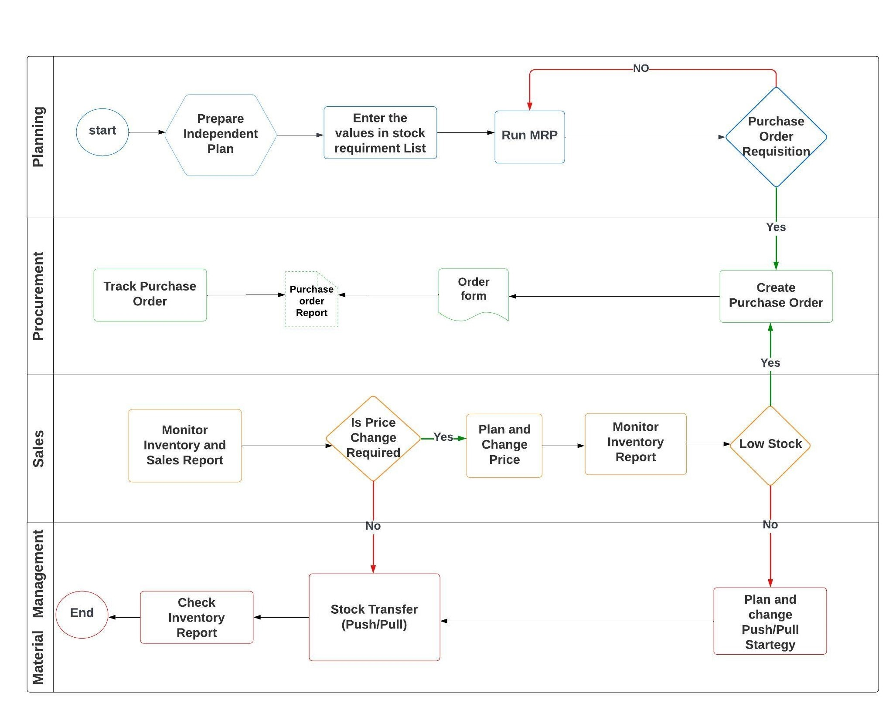
BPMN

Slide 5
Initial Strategy
1
2
3
Cost Optimization:
maintaining a gross margin of 12-13%.
Reduced operational costs.
Inventory Management:
Proactively reordered to prevent stockouts.
Monitored inventory reports for insights.
Pull and Push Utilization:
Made informed choices between Push and Pull techniques for stock transfers.
​

Slide 6
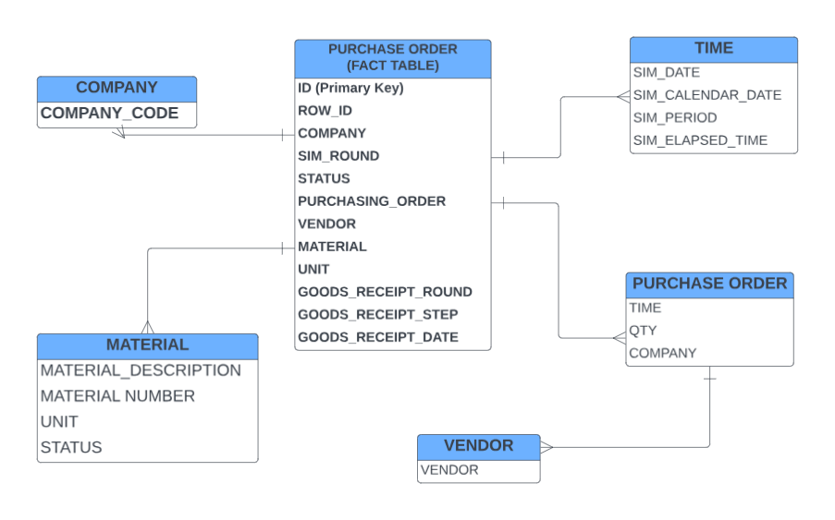
Snowflake Schema
The transactional information is contained in the fact table.
The dimension tables provide historical information such as time, company, material, vendor, and status.

Slide 7
Company Highest Revenue
By the end of round three, business NN had the most substantial revenue.
Our company OO comes fourth place in the ranking.
Having a high revenue is a crucial operation strategy for achieving the goal of high competitor value.
On the other hand, NN company did not win the game since its sales margin was not high enough to generate profits and income.

Slide 8
Purchase Order
We started with a large initial inventory of milk and yogurt.
Carefully managed inventory levels in the first round to stay within the specified boundary.
Reordered products strategically on three occasions to align with demand.
Avoided penalty charges by maintaining inventory levels below 4,000 units.

Slide 9
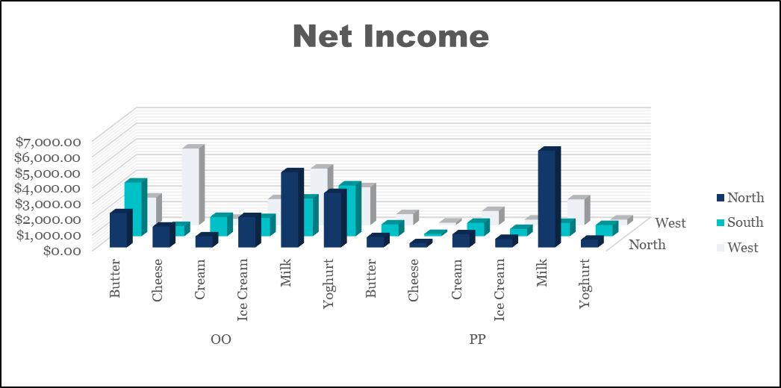
Net Income
Our company's main product has a notable consistency in profitability across all three locations.
The bars represent our performance, which fluctuates but remains steady, demonstrating our resilience and steady revenue generation.
As opposed to, PP's product line, it is subpar, with flat and unstable earnings.
Their financial trajectory is unsteady across most goods, except their milk variety, which shows the top earner in the North area.

Slide 10
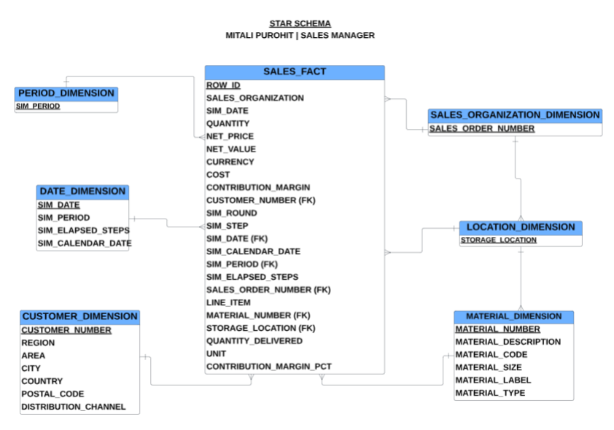
Insightful Integration: Sales Table Star Schema
Centralized repository: Sales fact table consolidates key metrics for comprehensive analysis.
Organizational context: Sales organization dimension provides insights into structural dynamics.
Temporal analysis: Date and period dimensions allow tracking of sales trends over time.
Granular insights: Customer, location, and material dimensions enhance segmentation for detailed analysis.

Slide 11
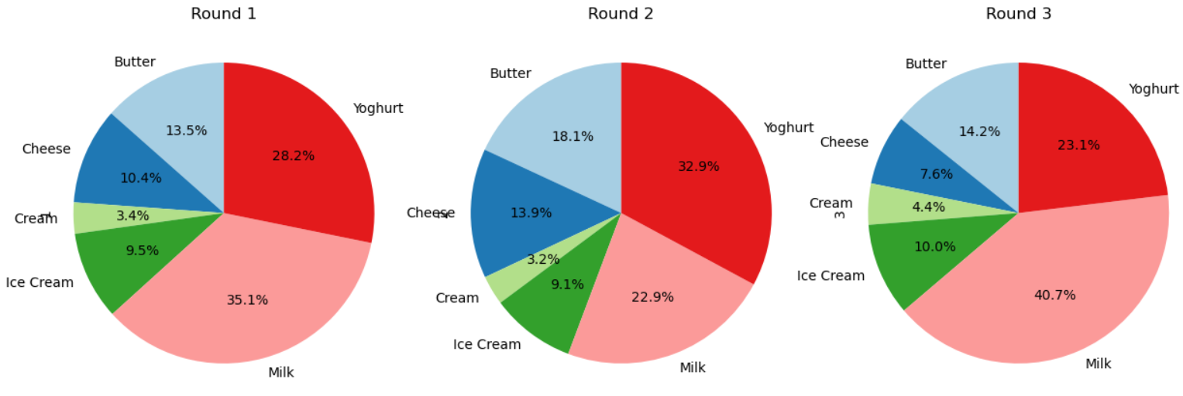
Dynamic Product Quantity Distribution Across Simulation Rounds
Pie chart illustrates product quantity distribution across three simulation rounds in percentage.
Strategic Gains:
Strategic Decision-Making
Adaptive Planning
Trend Identification
Operational Efficiency
Performance Evaluation
Resource Allocation Optimization
Market Responsiveness
Scenario Analysis
Improved Forecasting

Slide 12
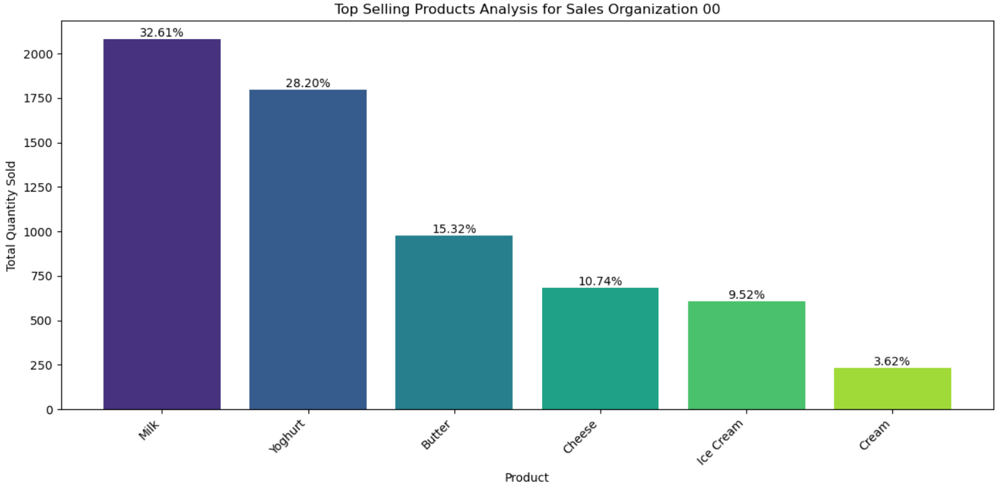
Top-Selling Products Analysis
Bar chart visually conveys sales quantity for key products, ensuring data clarity.
Enables quick identification of top-performing (Milk, Yoghurt) and underperforming (Cream) items.
Informs sales managers for focused decisions on product, marketing, and inventory.
Highlights growth opportunities by identifying sustained demand for Milk and Yoghurt.

Slide 13
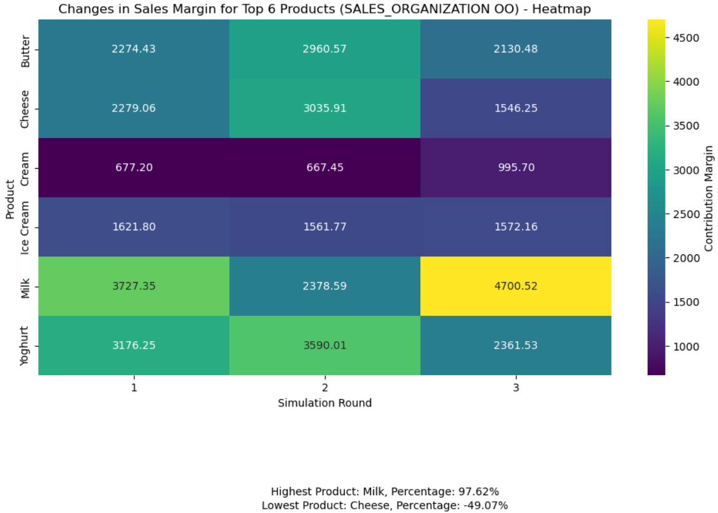
Profitability Insights: Analyzing Sales Margins
Heatmap provides a quick visual overview of sales margin changes.
Detects patterns for proactive sales strategy adjustments in response to market trends.
Sales margins guide focus on high-margin items, optimizing overall financial performance.
Highest Sales Margin:
97.62% for Milk
Lowest Sales Margin:
-49.07% for Cheese

Slide 14
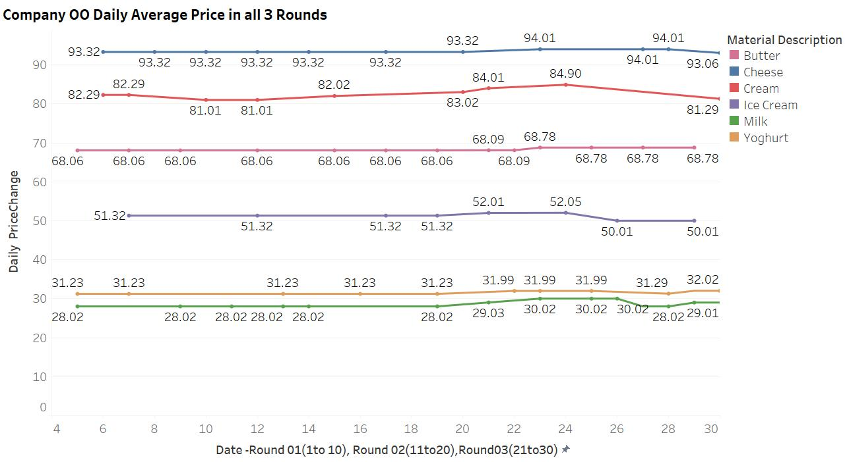
Daily Price Change Analysis
Prices of different products is stable across the three rounds.
Efficient profit generation and financial stability contribute to the enterprise's success in the ERPsim Logistics Game.

Slide 15
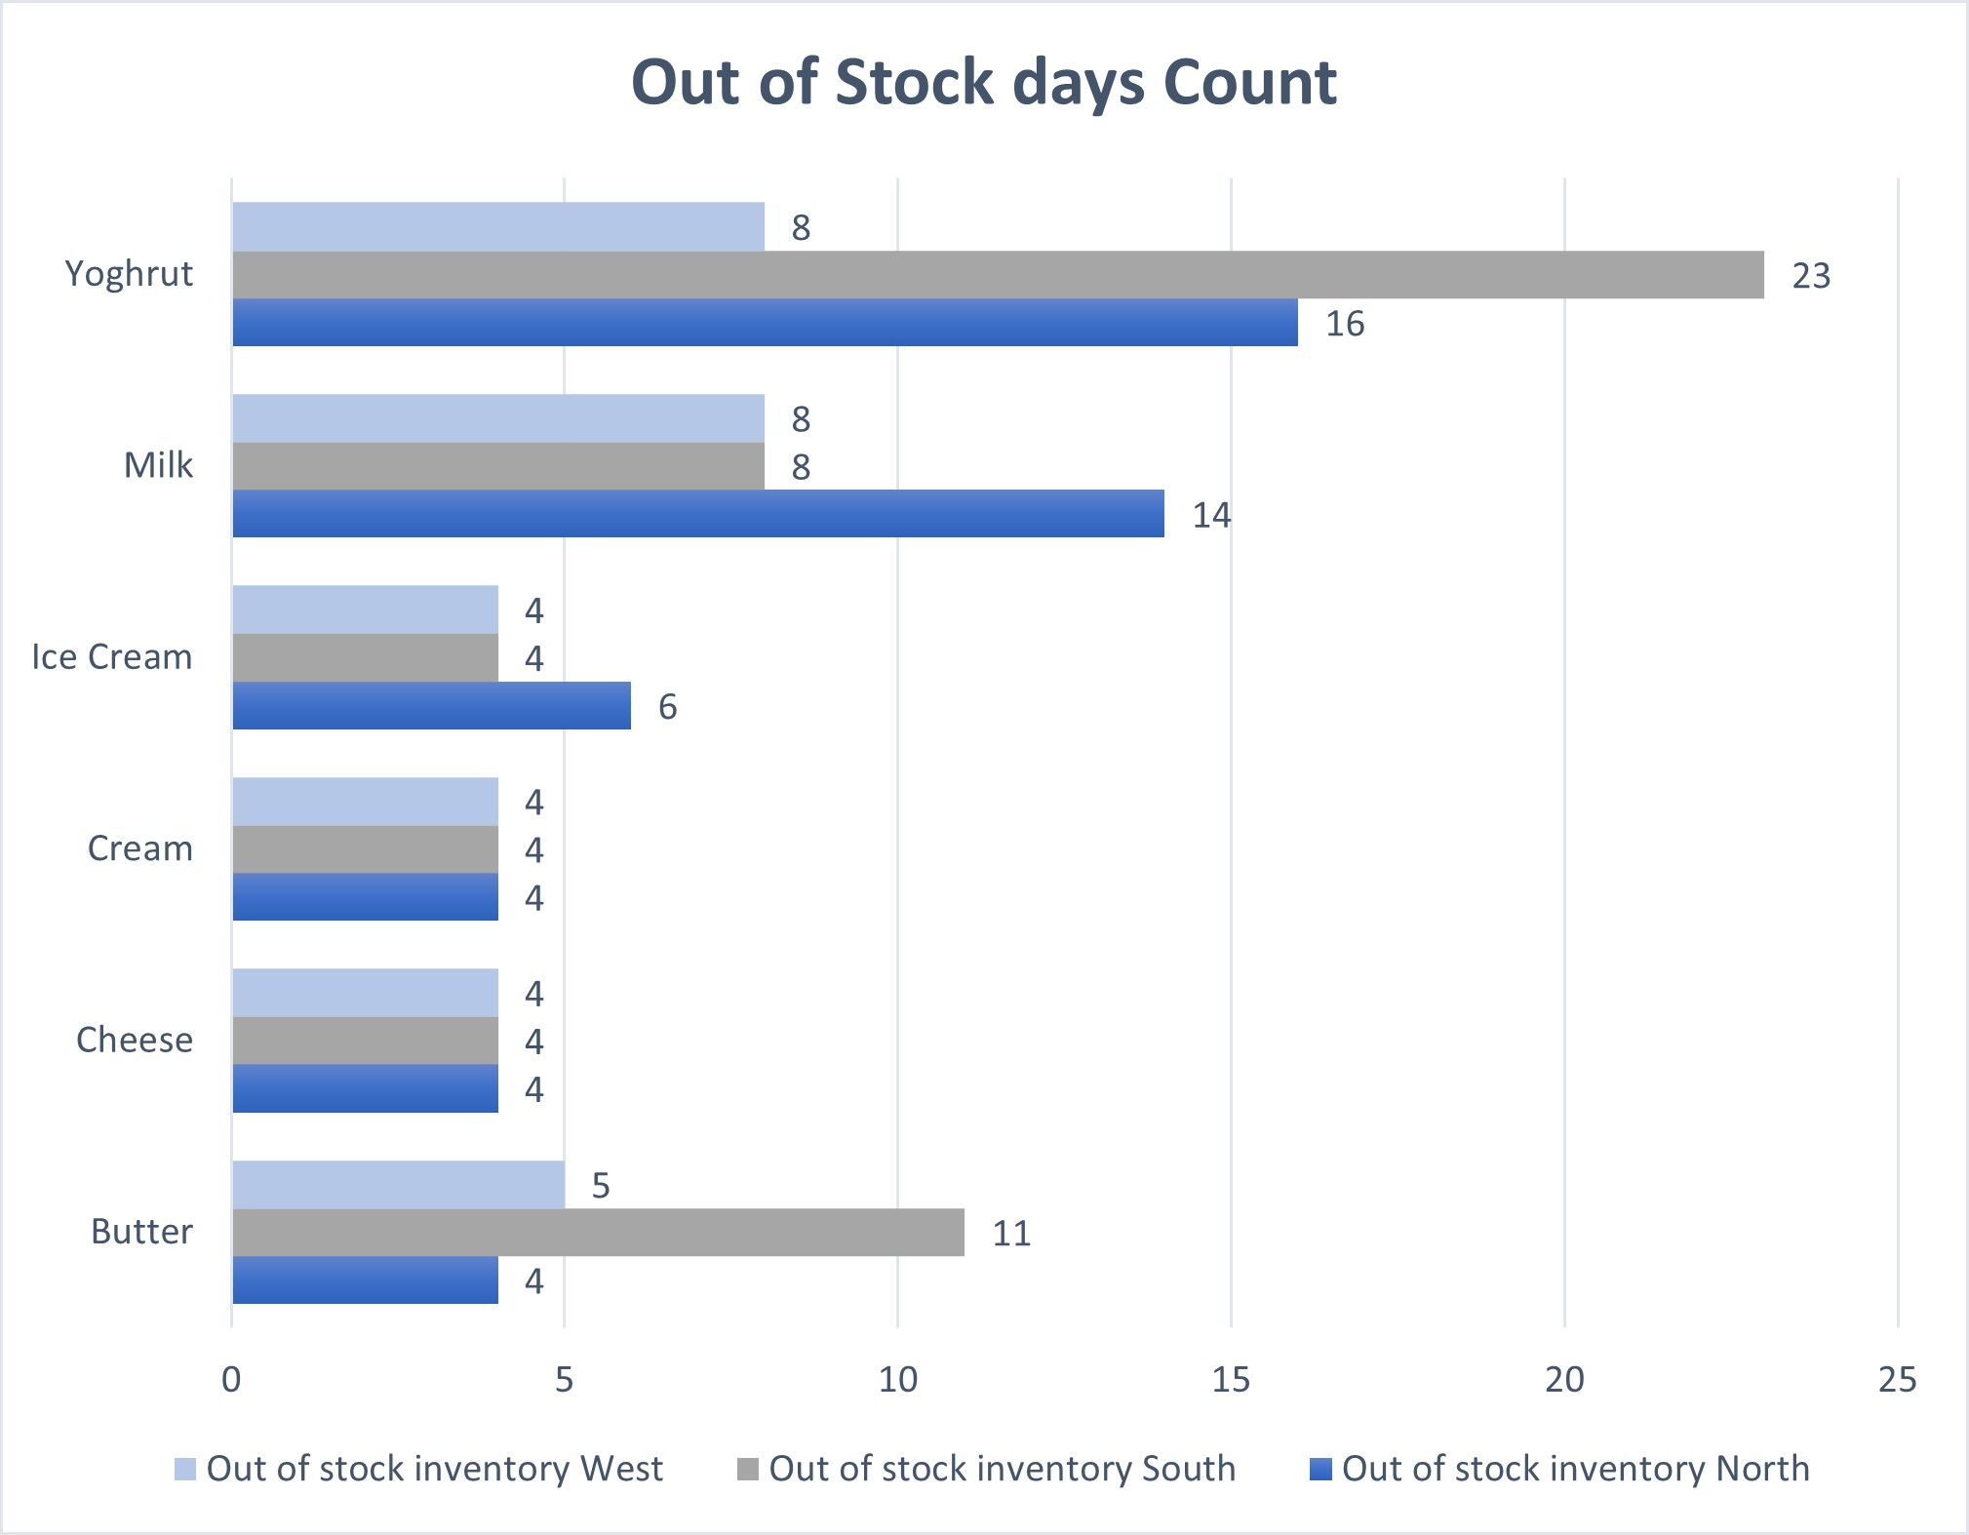
Out of stock Analysis
Maintained a more robust inventory, with only Milk, Butter, and Yoghurt facing occasional stockouts.
Least Cheese, Cream out of stock in all regions, contributing to better profitability.
Fewer zero inventory days compared to competitors.

Slide 16
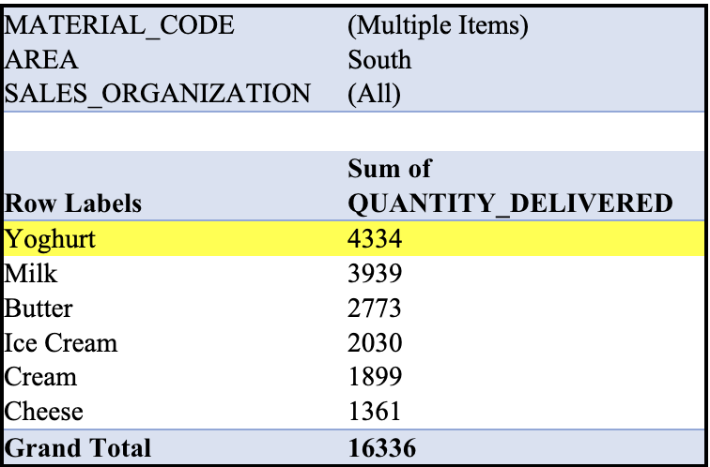
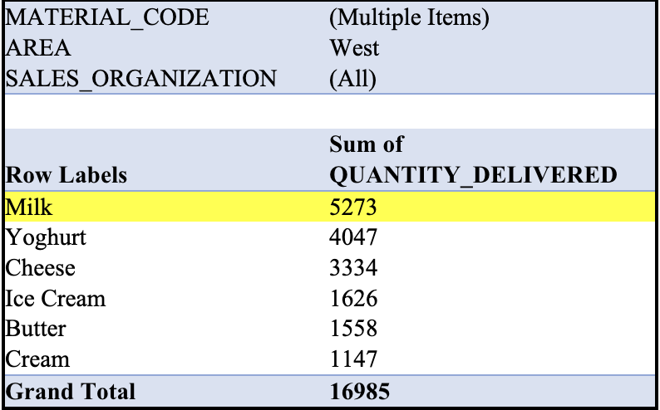
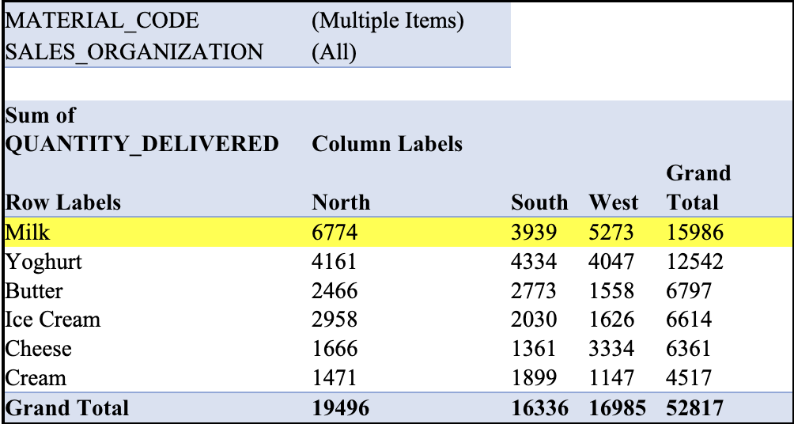
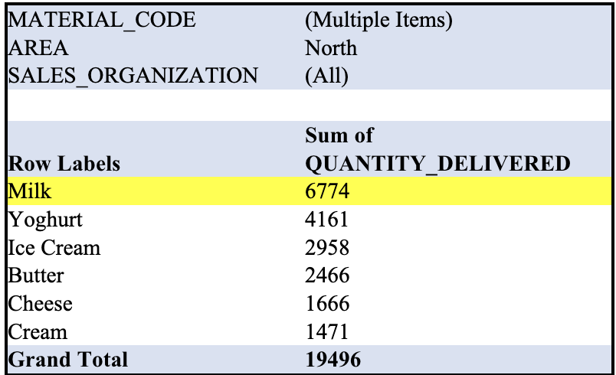
Highest sold product
Milk sold the most in the North with 6774.
Yoghurt sold the most in the South with a quantity of 4334.
Milk sold the most in the West with a quantity of 5273.
Milk sold the most in Total with quantity of 15986.

Slide 17
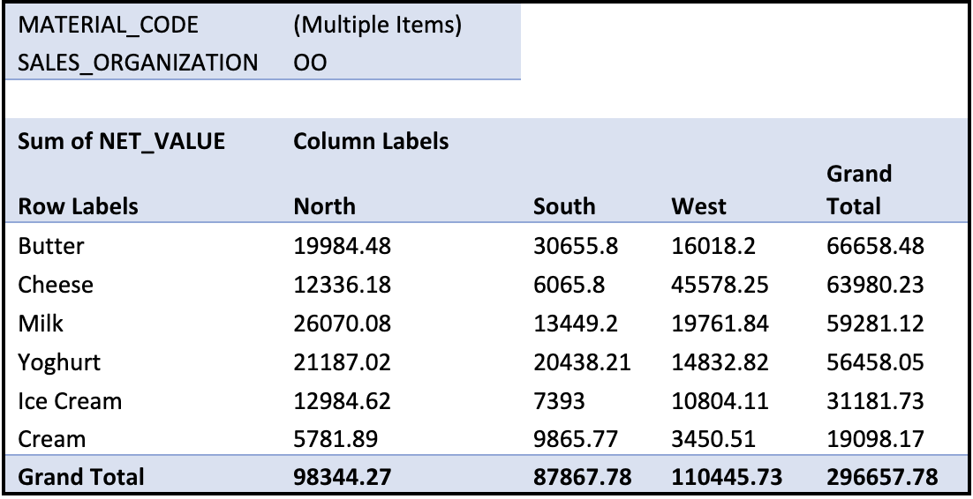
Highest revenue of a product
Our total revenue is 296,658. Butter has the highest total revenue of all products, of 66,658. The second highest is Cheese with a total revenue of 63,980. The next ones are milk, yoghurt, ice cream, and cream. Butter has the highest revenue in the South. Milk has the highest revenue in the North. Cheese has the highest revenue in the West.

Slide 18
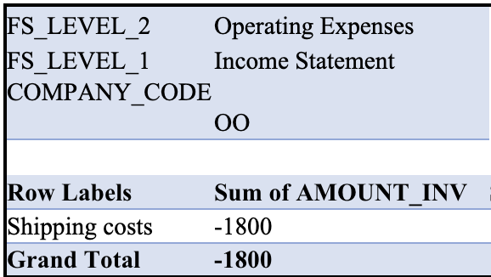
Warehousing and shipping
1800 EUR is charges for shipping for our team. We had 0 charges for warehousing.
We managed to not overstock our inventory, so thus we neglected warehousing prices. Also, we used Push strategy to reduce our shipping costs.

Slide 19
LESSONS
Should not have Low stock and overstock of inventory .
Maintain the Profit margin through out the game.
Effectively change the Push and Pull methodology.
Low sales with apt Profit margin also can increase the chance of winning.

Slide 20
Future strategy
Conducting thorough market research to identify product sale trends.
Stresses the importance of implementing strategies to boost product sales in simulation games.

Slide 21
Conclusion
Despite not achieving high sales, we had good profit margin of 13%, which helped us to increase the revenue.
Our cumulative income 39,456.56 dollars which is high compared to other competent teams.
Quickly strategized the plan through out the Round.
Co-ordination and effective teamwork helped to increase the chances of winning.
​

Slide 22

Thank
You

